Slide 1
DSA 503
Hypothesis Tests: Mean and Proportion

Slide 2
Hypothesis Tests: An introduction
Two Hypotheses
Rejection and Non-rejection Regions
Two Types of Errors
Tails of a Test

Slide 3
Hypothesis Tests: An introduction
Two Hypotheses
Rejection and Nonrejection Regions
Two Types of Errors
Tails of a Test

Slide 4
Two Hypotheses
Definition
A null hypothesis is a claim (or statement) about a population parameter that is assumed to be true until it is declared false.

Slide 5
Two Hypotheses
Definition
An alternative hypothesis is a claim about a population parameter that will be true if the null hypothesis is false.

Slide 6
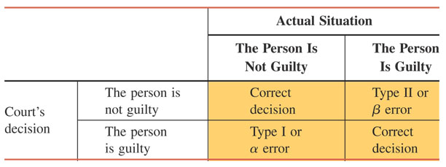
Two Types of Errors
Four Possible Outcomes for a Court Case

Slide 7
Two Types of Errors
Definition
A Type I error occurs when a true null hypothesis is rejected. The value of α represents the probability of committing this type of error; that is,
α = P(H₀ is rejected | H₀ is true)
The value of α represents the significance level of the test.

Slide 8
Two Types of Errors
Definition
A Type II error occurs when a false null hypotheses is not rejected (accepted). The value of β represents the probability of committing a Type II error; that is,
β = P (H₀ is not rejected | H₀ is false)
The value of 1 – β is called the power of the test. It represents the probability of not making a Type II error.
Power: P (H₀ is rejected | H₀ is false)= 1-β

Slide 9
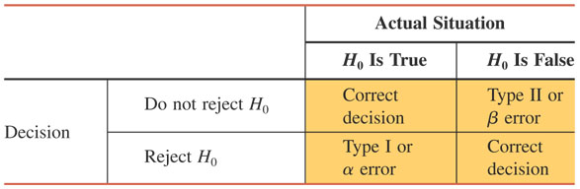
Four Possible Outcomes for a Test of Hypothesis

Slide 10
Tails of a Test
Definition
A two-tailed test has rejection regions in both tails, a left-tailed test has the rejection region in the left tail, and a right-tailed test has the rejection region in the right tail of the distribution curve.

Slide 11
A Two-Tailed Test
According to a survey by Consumer Reports magazine conducted in 2008, a sample of sixth graders selected from New York schools showed that their backpacks weighed an average of 18.4 pounds (USA TODAY, August 3, 2009). Another magazine wants to check whether or not this mean has changed since that survey. The key word here is changed or (different)
The mean weight of backpacks for sixth-graders in New York has changed if it has either increased or decreased since 2008. This is an example of a two tailed test.

Slide 12
A Two-Tailed Test
Let μ be the weight of backpacks for the current sixth-graders in New York. The two possible decisions are
  H₀ : μ = 18.4 pounds (The mean weight of backpacks for sixth-graders in New York has not changed)
  H₁ : μ ≠ 18.4 pounds (The mean weight of backpacks for sixth-graders in New York has changed)

Slide 13
A Two-Tailed Test
Whether a test is two–tailed or one–tailed is determined by the sign in the alternative hypothesis.
If the alternative hypothesis has a not equal to (≠) sign, it is a two–tailed test.

Slide 14
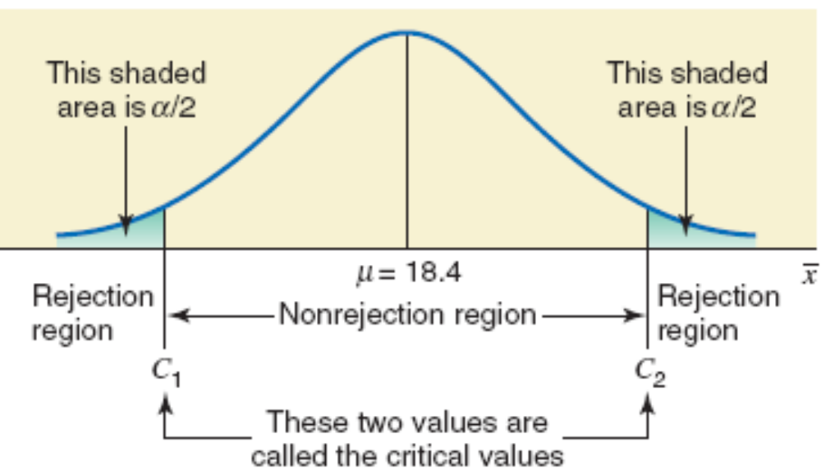
A two-tailed test.

Slide 15
A Left-Tailed Test
Reconsider the example of the mean amount of soda in all soft-drink cans produced by a company. The company claims that these cans, on average, contain 12 ounces of soda. However, if these cans contain less than the claimed amount of soda, then the company can be accused of cheating. Suppose a consumer agency wants to test whether the mean amount of soda per can is less than 12 ounces. Note that the key phrase this time is less than, which indicates a left-tailed test.

Slide 16
A Left-Tailed Test
Let μ be the mean amount of soda in all cans. The two possible decisions are
  H₀ : μ = 12 ounces (The mean is equal to 12 ounces)
  H₁ : μ < 12 ounces (The mean is less than 12 ounces)

Slide 17
A Left-Tailed Test
In this case, we can also write the null hypothesis as H₀ : μ ≥ 12. This will not affect the result of the test as long as the sign in H₁ is less than (<).
When the alternative hypothesis has a less than (<) sign, the test is always left–tailed.

Slide 18
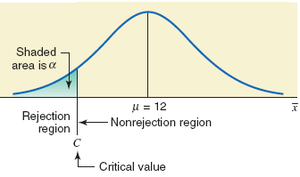
A left-tailed test.

Slide 19
A Right-Tailed Test
According to www.city-data.com, the average price of homes in West Orange, New Jersey, was $461,216 in 2007. Suppose a real estate researcher wants to check whether the current mean price of homes in this town is higher than $461,216. The key phrase in this case is higher than, which indicates a right-tailed test.

Slide 20
A Right-Tailed Test
Let μ be the current mean price of homes in this town. The two possible decisions are
  H₀ : μ = $461,216 (The current mean price of homes in this town is not higher than $461,216)
  H₁ : μ > $461,216 (The current mean price of homes in this town is higher than $461,216)

Slide 21
A Right-Tailed Test
When the alternative hypothesis has a greater than (>) sign, the test is always right–tailed.

Slide 22
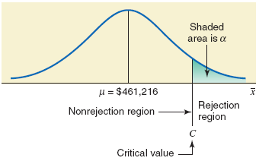
A right-tailed test.

Slide 23
Two Procedures & 6 Steps
p-value approach
State the null and alternative hypothesis.
Select the distribution to use.
Test statistic.
Calculate the p–value
Make a decision.
Conclusion

Slide 24
6 Steps: critical-value approach
  State the null and alternative hypotheses
  Select the distribution to use
  Critical values + Regions
  Test statistic
  Decision
  Conclusion

Slide 25
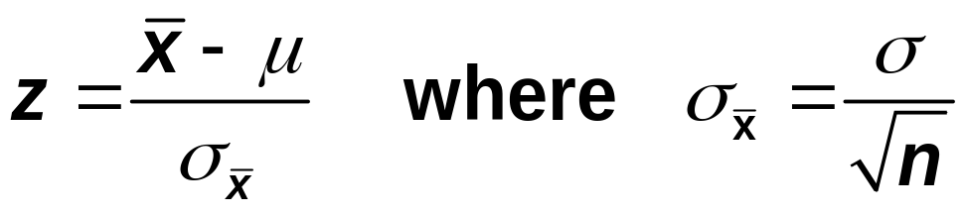
Hypothesis Tests About μ : σ known
When using the normal distribution, the value of z for x for a test of hypothesis about μ is computed as follows:
The value of z calculated for x using this formula is also called the observed value of z.

Slide 26
Example
At Canon Food Corporation, it used to take an average of 90 minutes for new workers to learn a food processing job. Recently the company installed a new food processing machine. The supervisor at the company wants to find if the mean time taken by new workers to learn the food processing procedure on this new machine is different from 90 minutes.
A sample of 20 workers showed that it took, on average, 85 minutes for them to learn the food processing procedure on the new machine.
It is known that the learning times for all new workers are normally distributed with standard deviation of 7 minutes.
Find the p–value for the test that the mean learning time for the food processing procedure on the new machine is different from 90 minutes.
What will your conclusion be if α = .01?

Slide 27
Example: Solution
Step 1. Hypothesis:
H₀: μ = 90 (mean learning time for the food processing is 90 minutes)
H₁: μ ≠ 90 (mean learning time for the food processing is different from 90 minutes)
Step 2. Distribution: Normal

Slide 28
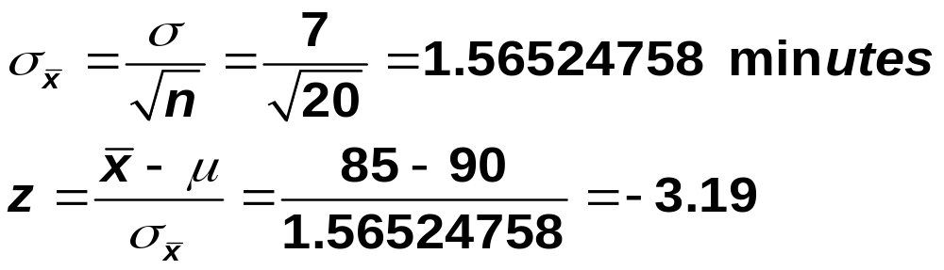
Example: Solution
Step 3: Test statistic
Step 4: p-value = 2(.0007) = .0014

Slide 29
Example: Solution
Step 5. Decision: Because α = .01 is greater than the p-value of .0014, we reject the null hypothesis.
Step 6. Conclusion: Therefore, we conclude that the mean time for learning the food processing procedure on the new machine is different from 90 minutes.

Slide 30
Example
The management of Priority Health Club claims that its members lose an average of 10 pounds or more within the first month after joining the club. A consumer agency that wanted to check this claim took a random sample of 36 members of this health club and found that they lost an average of 9.2 pounds within the first month of membership with a population standard deviation of 2.4 pounds. Find the p–value for this test. What will you decision be if α = .01?
What if α = .05?

Slide 31
Example: Solution
Step 1: H₀: μ ≥ 10 H₁: μ < 10
Step 2: The population standard deviation σ is known, the sample size is large (n > 30). Due to the Central Limit Theorem, we will use the normal distribution to find the p–value and perform the test.

Slide 32
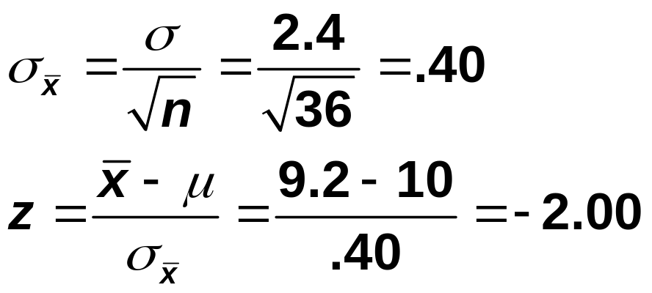
Example: Solution
Step 3: Test Statistic
Step4: p-value = .0228

Slide 33
Example: Solution
Step 4: Decision:
Since α = .01 is less than the p-value of .0228, we do not reject the null hypothesis at this significance level. Consequently, we conclude that the mean weight lost within the first month of membership by the members of this club is 10 pounds or more.
Step 4: Conclusion: Because α = .05 is greater than the p-value of .0228, we reject the null hypothesis at this significance level. Therefore, we conclude that the mean weight lost within the first month of membership by the members of this club is less than 10 pounds.

Slide 34
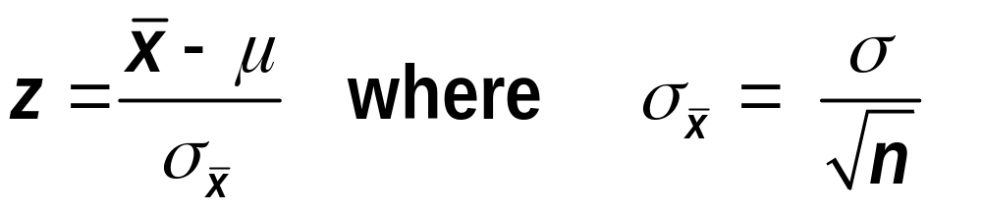
HYPOTHESIS TESTS ABOUT :  KNOWN
Test Statistic
In tests of hypotheses about μ using the normal distribution, the random variable
is called the test statistic. The test statistic can be defined as a rule or criterion that is used to make the decision whether or not to reject the null hypothesis.

Slide 35
Example
The TIV Telephone Company provides long-distance telephone service in an area. According to the company’s records, the average length of all long-distance calls placed through this company in 2009 was 12.44 minutes. The company’s management wanted to check if the mean length of the current long-distance calls is different from 12.44 minutes. A sample of 150 such calls placed through this company produced a mean length of 13.71 minutes with a population standard deviation of 2.65 minutes. Using the 2% significance level, can you conclude that the mean length of all current long-distance calls is different from 12.44 minutes?

Slide 36
Example: Solution
Step 1: H₀ : μ = 12.44 (…………..)
H₁ : μ ≠ 12.44 (………….)
Step 2: The population standard deviation σ is known, and the sample size is large (n > 30). Due to the Central Limit Theorem, we will use the normal distribution to perform the test.

Slide 37
Example: Solution
Step 3: α = .02
The ≠ sign in the alternative hypothesis indicates that the test is two-tailed
Area in each tail = α / 2= .02 / 2 = .01
The z values for the two critical points are -2.33 and 2.33

Slide 38
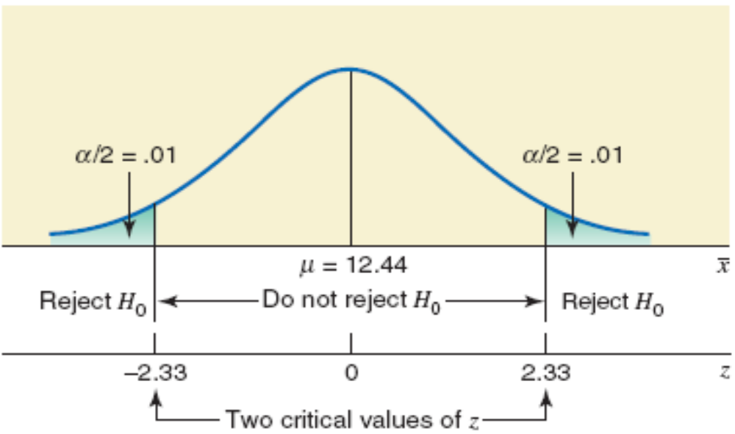
Figure 9.9

Slide 39
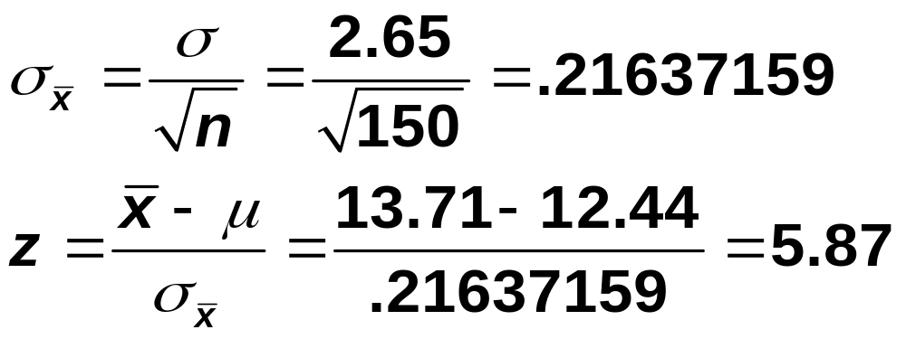
Example 9-3: Solution
Step 4:

Slide 40
Example: Solution
Step 5: This value of z = 5.87 is greater than the critical value of z = 2.33, and it falls in the rejection region in the right tail in Figure 9.9. Hence, we reject H₀.
Step 6: we conclude that based on the sample information, it appears that the mean length of all such calls is not equal to 12.44 minutes.

Slide 41
Example
The mayor of a large city claims that the average net worth of families living in this city is at least $300,000.
A random sample of 25 families selected from this city produced a mean net worth of $288,000.
Assume that the net worths of all families in this city have a normal distribution with the population standard deviation of $80,000.
Using the 2.5% significance level, can you conclude that the mayor’s claim is false?

Slide 42
Example: Solution
Step 1: H₀ : μ ≥ $300,000
H₁ : μ < $300,000
Step 2: The population standard deviation σ is known, the sample size is small (n < 30), but the population distribution is normal. Consequently, we will use the normal distribution to perform the test.

Slide 43
Example: Solution
Step 3: α = .025
The < sign in the alternative hypothesis indicates that the test is left-tailed
Area in the left tail = α = .025
The critical value of z is -1.96

Slide 44
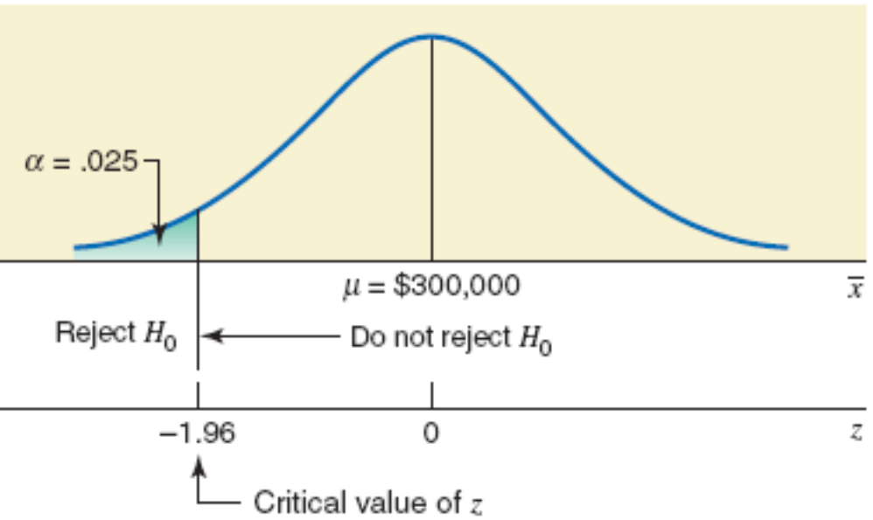
Figure

Slide 45
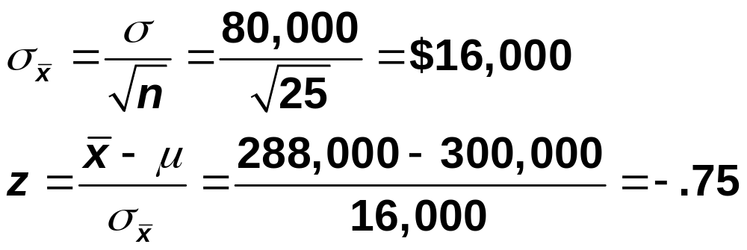
Example: Solution
Step 4:

Slide 46
Example: Solution
Step 5: This value of z = -.75 is greater than the critical value of z = -1.96, and it falls in the nonrejection region. As a result, we fail to reject H₀. Therefore, we can state that based on the sample information, it appears that the mean net worth of families in this city is not less than $300,000.

Slide 47
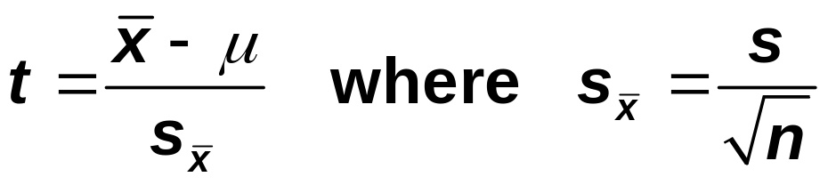
Hypothesis Tests About μ : σ not known
Test Statistic
The value of the test statistic t for the sample mean x is computed as
df = n – 1
The value of t calculated for x by using this formula is also called the observed value of t.

Slide 48
Example 9-5
A psychologist claims that the mean age at which children start walking is 12.5 months. Carol wanted to check if this claim is true. She took a random sample of 18 children and found that the mean age at which these children started walking was 12.9 months with standard deviation 0.80.
It is known that the ages at which all children start walking are approximately normally distributed.
Find the p-value for the test that the mean age at which all children start walking is different from 12.5 months. What will your conclusion be if the significance level is 1%?

Slide 49
Example 9-5: Solution
Step 1: Hypothesis:
H₀ : μ = 12.5 (mean age at which all children start walking is equal to 12.5 months)
H₁ : μ ≠ 12.5 (mean age at which all children start walking is different from 12.5 months)
Step 2: The population standard deviation σ is not known, consequently, we will use the t distribution.

Slide 50
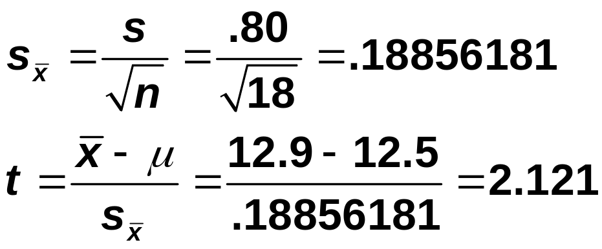
Example 9-5: Solution
Step 3. Test Statistic:
and df = n – 1 = 18 – 1 = 17
Step 4. p-value:
.02< p-value <.05
p-value =0.03 (say)

Slide 51
Example 9-5: Solution
Step 5. Decision: Since p-value=0.03 is greater than alpha, α = .01, so we fail to reject H0.
Step 6. Conclusion: We conclude that the mean age at which all children start walking is not different from 12.5 months.

Slide 52
Example 9-6
Grand Auto Corporation produces auto batteries. The company claims that its top-of-the-line Never Die batteries are good, on average, for at least 65 months.
A consumer protection agency tested 45 such batteries to check this claim. It found the mean life of these 45 batteries to be 63.4 months with a standard deviation of 3 months. Find the p-value for the test that mean life of all such batteries is less than 65 months. What will your conclusion be if the significance level is 2.5%?

Slide 53
Example 9-6: Solution
Step 1: H₀ : μ ≥ 65 (…………..)
H₁ : μ < 65 (………….)
Step 2: The population standard deviation σ is not known and the sample size is large (n > 30). Consequently, we will use the t distribution to find the p-value for the test.

Slide 54
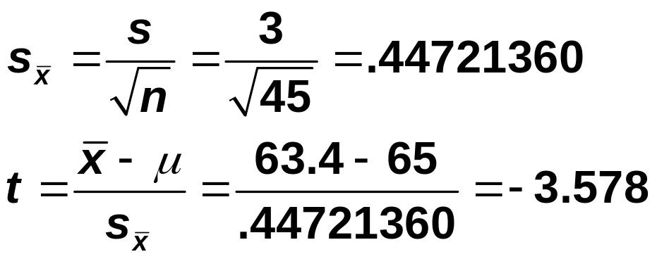
Example 9-6: Solution
Step 3: Test statistic
df = n – 1 = 45 – 1 = 44
Step 4: p-value = .0005 (Approximately)

Slide 55
Example 9-7
Refer to Example 9-5. A psychologist claims that the mean age at which children start walking is 12.5 months. Carol wanted to check if this claim is true. She took a random sample of 18 children and found that the mean age at which these children started walking was 12.9 months with a standard deviation of .80 month.
Using the 1% significance level, can you conclude that the mean age at which all children start walking is different from 12.5 months?
Assume that the ages at which all children start walking have an approximately normal distribution.

Slide 56
Example 9-7: Solution
Step 1: H₀ : μ = 12.5 (………………..)
H₁ : μ ≠ 12.5 (………………...)
Step 2: The population standard deviation σ is not known, the sample size is small (n < 30), and the population is normally distributed. Consequently, we will use the t distribution to perform the test.

Slide 57
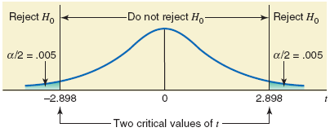
Example 9-7: Solution
Step 3. Critical values + Figures:
Level of significance α = .01
df = n – 1 = 18 – 1 = 17
The critical values are -2.898 and 2.898

Slide 58
Example 9-7: Solution
Step 4:Test statistic:
Step 5. Decision:
Since t = 2.121 falls in the non-rejection region, so we fail to reject H0.
Step6. Conclusion: We conclude that the mean age at which all children start walking is not different from 12.5 months.

Slide 59
Example 9-8
The management at Massachusetts Savings Bank is always concerned about the quality of service provided to its customers. With the old computer system, a teller at this bank could serve, on average, 22 customers per hour. The management noticed that with this service rate, the waiting time for customers was too long. Recently the management of the bank installed a new computer system in the bank, expecting that it would increase the service rate and consequently make the customers happier by reducing the waiting time.

Slide 60
Example 9-8
To check if the new computer system is more efficient than the old system, the management of the bank took a random sample of 70 hours and found that during these hours the mean number of customers served by tellers was 27 per hour with a standard deviation of 2.5. Testing at the 1% significance level, would you conclude that the new computer system is more efficient than the old computer system?

Slide 61
Example 9-8: Solution
Step 1: H₀ : μ = 22 (……………)
H₁ : μ > 22 (…………..)
Step 2: The population standard deviation σ is not known and the sample size is large (n > 30). Consequently, we will use the t distribution to perform the test.

Slide 62
Example 9-8: Solution
Step 3: Significance level = .01. The > sign in the alternative hypothesis indicates that the test is right-tailed and the rejection region lies in the right tail.
Area in the right tail = α = .01
df = n – 1 = 70 – 1 = 69
The critical value for t for 69 df and .01 area in the right tail is 2.382.

Slide 63
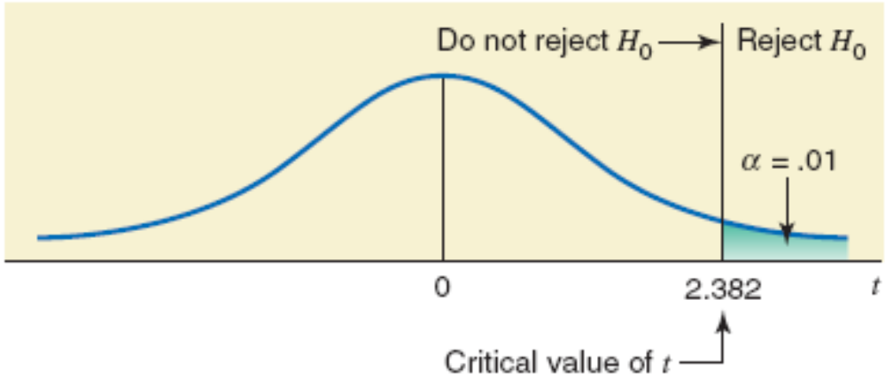
Figure 9.14

Slide 64
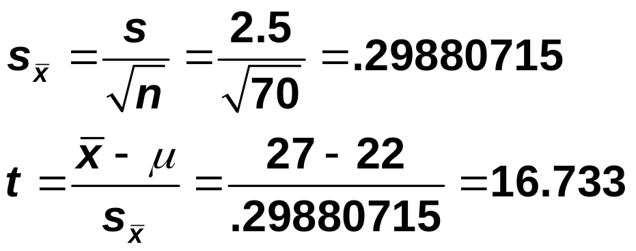
Example 9-8: Solution
Step 4:
The value of the test statistic t = 16.733 is greater than the critical value of t = 2.382, and it falls in the rejection region. Consequently, we reject H0. As a result, we conclude that the value of the sample mean is too large compared to the hypothesized value of the population mean, and the difference between the two may not be attributed to chance alone.

Slide 65


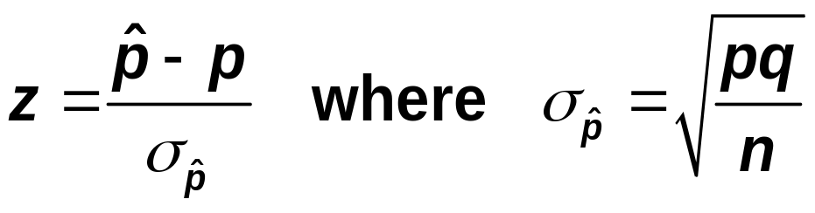
HYPOTHESIS TESTS ABOUT A POPULATION PROPORTION: LARGE SAMPLES
Test Statistic
The value of the test statistic z for the sample proportion, , is computed as
The value of p that is used in this formula is the one from the null hypothesis. The value of q is equal to 1-p. The value of z calculated for using the above formula is also called the observed value of z. (large sample: np>5 and nq>5).

Slide 66
Example 9-9
According to a Nationwide Mutual Insurance Company Driving While Distracted Survey conducted in 2008, 81% of the drivers interviewed said that they have talked on their cell phones while driving (The New York Times, July 19, 2009).
The survey included drivers aged 16 to 61 years selected from 48 states. Assume that this result holds true for the 2008 population of all such drivers in the United States.
In a recent random sample of 1600 drivers aged 16 to 61 years selected from the United States, 83% said that they have talked on their cell phones while driving.

Slide 67
Example 9-9
Find the p-value to test the hypothesis that the current percentage of such drivers who have talked on their cell phones while driving is different from 81%.
What is your conclusion if the significance level is 5%?

Slide 68
Example 9-9: Solution
Step 1: H₀ : p = .81 (……………….)
H₁ : p ≠ .81 (………………)
Step 2. Distribution: Normal
Since large sample:
np = 1600(.81) = 1296 > 5 and
nq = 1600(.19) = 304 > 5.

Slide 69
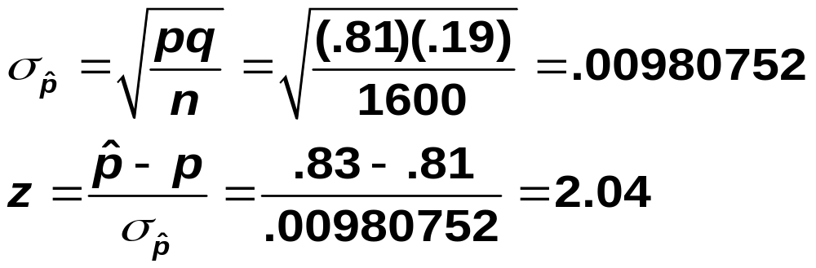
Example 9-9: Solution
Step 3. Test Statistic:
Step 4. p-value = 2 (.0207) = .0414

Slide 70
Example 9-9: Solution
Step 5. Decision:
Since α=0.05 is greater than p-value=0.0414, so we reject the null hypothesis.
Step 6. Conclusion:
We conclude that the current percentage of all U.S. drivers aged 16 to 61 years who have talked on their cell phones while driving is different from 81%.

Slide 71
Example 9-10
When working properly, a machine that is used to make chips for calculators does not produce more than 4% defective chips.
Whenever the machine produces more than 4% defective chips, it needs an adjustment.
To check if the machine is working properly, the quality control department at the company often takes samples of chips and inspects them to determine if they are good or defective.

Slide 72
Example 9-10
One such random sample of 200 chips taken recently from the production line contained 12 defective chips.
Find the p-value to test the hypothesis whether or not the machine needs an adjustment.
What would your conclusion be if the significance level is 2.5%?

Slide 73
Example 9-10: Solution
Step 1: H₀: p ≤ .04 (……..)
H₁: p > .04 (…….)
Step 2: To check whether the sample is large, we calculate the values of np and nq:
np = 200(.04) = 8 > 5
nq = 200(.96) = 192 > 5
Consequently, we will use the normal distribution to find the p-value for this test.

Slide 74
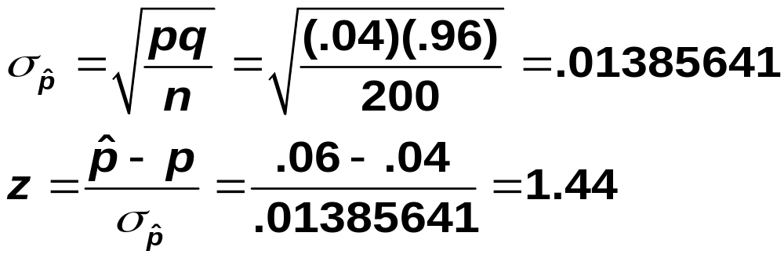
Example 9-10: Solution
Step 3: The > sign in the alternative hypothesis indicates that the test is right-tailed.
Step 4: p-value = .0749

Slide 75
Example 9-10: Solution
Step 5. Decision: Since α = .025 is less than p-value= .0749, so we fail to reject H0.
Step 6. Conclusion: We conclude that the machine does not need an adjustment.
HW: Solve the problem using critical value approach

Slide 76
Example 9-11
Refer to Example 9-9. According to a Nationwide Mutual Insurance Company Driving While Distracted Survey conducted in 2008, 81% of the drivers interviewed said that they have talked on their cell phones while driving (The New York Times, July 19, 2009). The survey included drivers aged 16 to 61 years selected from 48 states. Assume that this result holds true for the 2008 population of all such drivers in the United States. In a recent random sample of 1600 drivers aged 16 to 61 years selected from the United States, 83% said that they have talked on their cell phones while driving.

Slide 77
Example 9-11
Using the 5% significance level, can you conclude that the current percentage of such drivers who have talked on their cell phones while driving is different from 81%.

Slide 78
Example 9-11: Solution
Step 1: Hypothesis:
H₀ : p = .81 (percentage of drivers talked on cell phones while driving is 81%)
H₁ : p ≠ .81 (percentage of drivers talked on cell phones while driving is different from 81%)
Step2. Distribution:
Normal since
np = 1600(.81) = 1296 > 5 and
nq = 1600(.19) = 304 > 5.

Slide 79
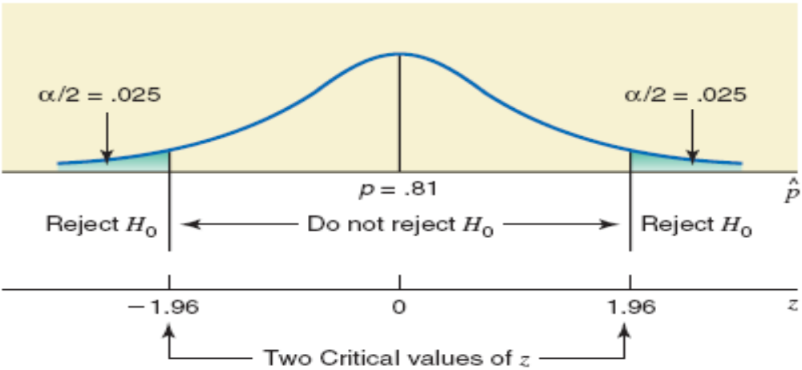
Example 9-11: Solution
Step 3: Critical Values + Figure
Area in each tail = α / 2 = .05 / 2 = .025
The critical values of z are -1.96 and 1.96.

Slide 80
Example 9-11: Solution
Step 4. Test statistic:

Slide 81
Example 9-11: Solution
Step 5: Decision: The value of test statistic z = 2.04 falls in the rejection region. As a result, we reject H0.
Step 6. Conclusion: We conclude that the current percentage of all U.S. drivers aged 16 to 61 years who have talked on their cell phones while driving is different from 81%.

Slide 82
Example 9-12
Direct Mailing Company sells computers and computer parts by mail. The company claims that at least 90% of all orders are mailed within 72 hours after they are received. The quality control department at the company often takes samples to check if this claim is valid.
A recently taken sample of 150 orders showed that 129 of them were mailed within 72 hours. Do you think the company’s claim is true?
Use a 2.5% significance level.

Slide 83
Example 9-12: Solution
Step 1: H₀ : p ≥ .90 (………….)
H₁ : p < .90 (……….)
Step 2: To check whether the sample is large, we calculate the values of np and nq:
np = 150(.90) = 135 > 5
nq = 150(.10) = 15 > 5
Consequently, we will use the normal distribution to make the test.

Slide 84
Example 9-12: Solution
Step 3: Significance level = .025. The < sign in the alternative hypothesis indicates that the test is left-tailed, and the rejection region leis in the left tail.
The critical values of z for .0250 area in the left tail is -1.96.

Slide 85
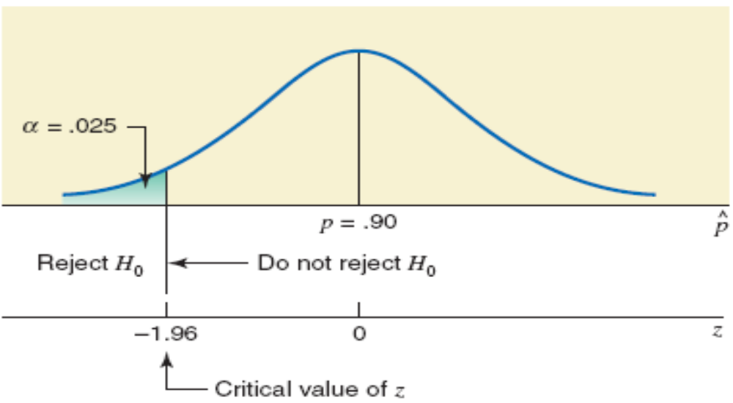
Figure 9.18 The critical values of z

Slide 86
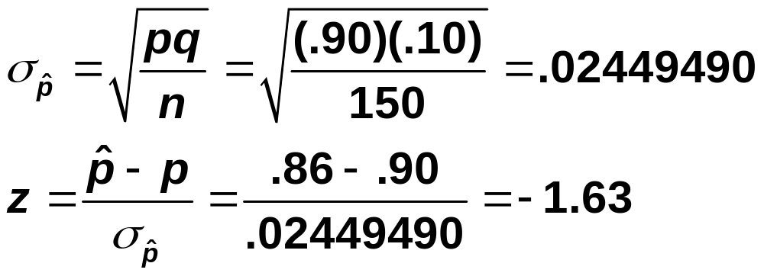
Example 9-12: Solution
Step 4. Test Statistic
(p-hat=129/150=0.86)

Slide 87
Example 9-12: Solution
Step 5. Decision: The value of test statistic z = -1.63 is greater than the critical value of z = -1.96, and it falls in the non-rejection region. Therefore, we fail to reject H₀.
Step 6. Conclusion: …………………
The End.

